Slide 1

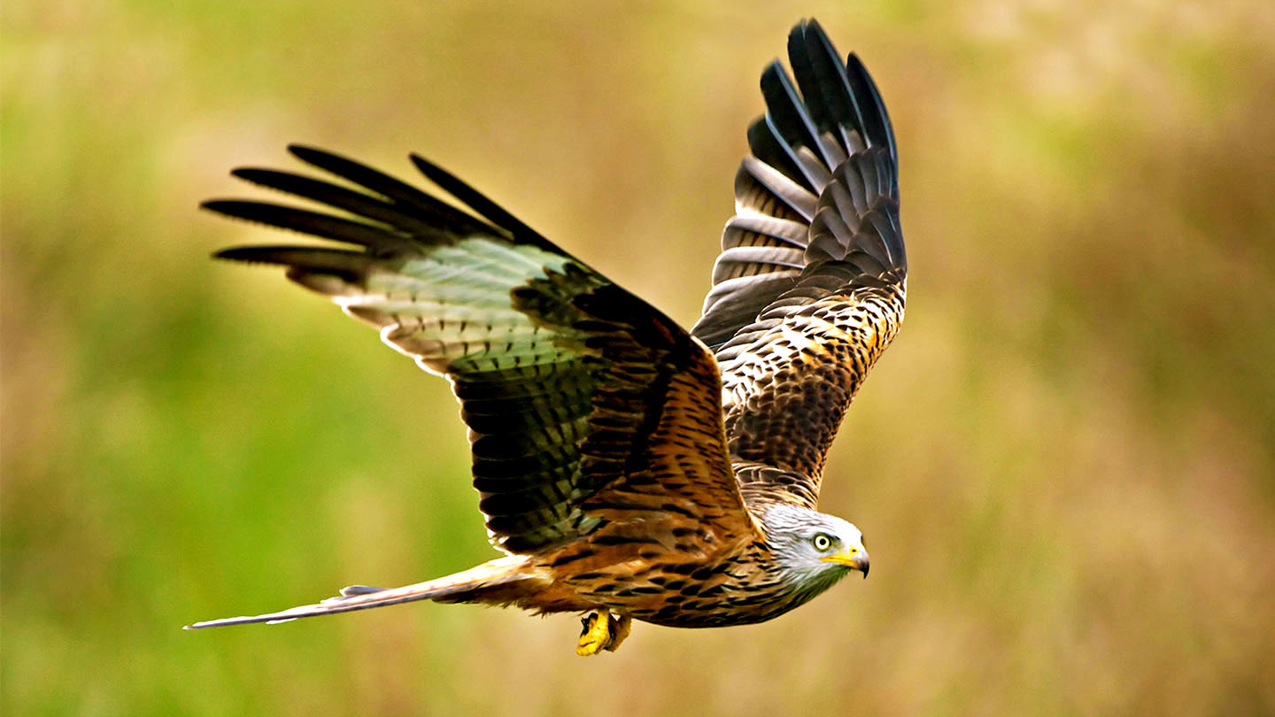




Huby C of E Primary School
Red Kites
Year 5 & 6 pupils
“Whatever you do, work at it with all your heart” Colossians 3:v23
Welcome back!
I hope you all had a lovely summer break. In school we have been preparing for a very busy term and I have been looking forward moving classes!
Red Kites this year will be taught by myself (Mr Hartley), supported by Teaching Assistant Mrs Rose every morning. We also have Teaching Assistant Miss Greenwood,
who will be supporting a child 1-1 full time.
On Thursday afternoons Red Kites will be taught computing by Mr Vincent and French by Mrs Broadhurst.
If you have any queries throughout the term please just ask, either by emailing me through admin@huby.n-yorks.sch.uk or for a chat in person at the end of the school day.
It is important for your child to continue their learning at home;
Reading; even though the children are reading fluently it is
still important that your child reads their school books several times a week. The more the children read, the better understanding they will have when completing reading comprehensions, which they will have to do each year until year 11. Please sign your name in their Reading Record when your child has read.
Mathletics; weekly tasks will be set for the children on Mathletics. These tend to match what your child has been taught in school at the same time. The tasks help strengthen children’s understanding of what they have been taught so please login into Mathletics to complete the tasks.
TTRS; practising times tables regularly will help keep their maths skills sharp.
**NEW for Year 6 ONLY** Year 6 children will be given CGP learning books, as shown below. Every Friday the children will be given page numbers to complete in each book. I will tell the children the page numbers, as well as writing a message on the class page on Class DOJO. The Year 6 children will need to hand in these two books, with the relevant pages completed, every Wednesday.
Red Kites PE days are Wednesdays and Fridays. On Wednesdays the PE lesson will be gymnastics, taught by Mrs Broadhurst. On Fridays the children will be extending their netball skills. On PE days please send your child in wearing the correct PE kits.

Slide 2

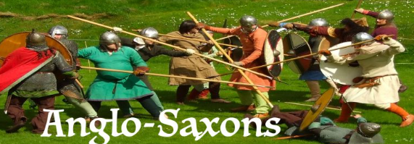


For Guided Reading we are reading Brightstorm, which is an action packed adventure story. The children will be reading, discussing and answering questions about this story every day.
Initially in Literacy we are basing our writing around this story in the form of newspaper reports and diary entries, as well as focussing on parts of our Grammar.
In history we will be learning all about Anglo Saxons. Lessons will include creating timelines, learning about settlements and burial sites, as well as the life of an Anglo Saxon.
Science; In this topic, the children learn about materials and how they change. First they will test properties of materials before looking at how materials dissolve, what a solution is and evaporation. Finally, the children compare reversible and irreversible changes.
RE will see the children learn about Creation and the contrasting views of Christians and scientists.
In maths, for the first three weeks, the children will extend their learning of place value before moving onto addition and subtraction, fractions and measurement.
As you are aware, on 31st October (the week after half term), all Year 5 and Year 6 children will be going to Peat Rigg outdoor training centre, near Pickering, accompanied by myself and Mrs Broadhurst. We are holding an open evening in school for children and parents on Thursday 22nd September at 3.30pm where we will discuss what will happen during the residential and answer any questions you may have.

